Slide 1
BT2102 Assignment 1
Group 05
Muhammad Rilwan A0216929U
Wong Deshun A0222482L
Han Jun Ding A0221230E
Jess Raphael Ong A0216807A
Larvine Shan A0200040M
Wang Wen Pin David A0221064W

Slide 2
Customer, Administrator
CUSTOMER
ADMINISTRATOR
CustomerID
Phone Number
Administrator Name
Administrator ID
CustomerPassword
Email Address
Administrator Password
Gender
CustomerName
Phone Number
Gender
Address

Slide 3
Products, Items
PRODUCTS
ITEMS
ProductID
Warranty
ItemID
Purchase
Status
Model
Cost
Service Status
Price
Inventory
Category

Slide 4
ServiceFee, Service, Request
REQUEST
SERVICE FEE
RequestID
Request Status
Payment Settlement Date
Request Date
Payment Creation Date
SERVICE
DueDate
Service Fee Amount
ServiceID

Slide 5
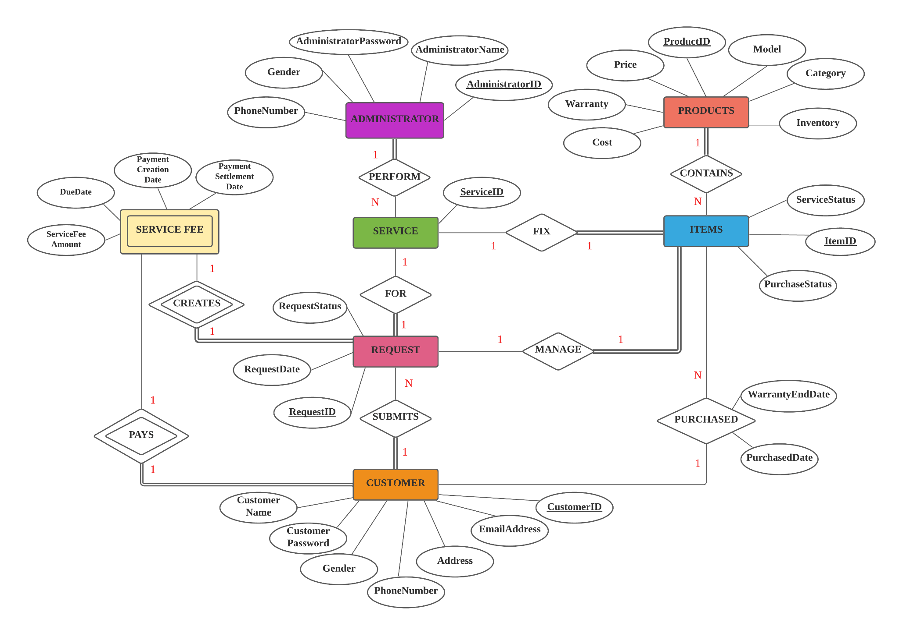
Conceptual Data Model

Slide 6
Refine Relational Schema
Entities
Administrator (AdministratorID, AdministratorName, Gender, PhoneNumber, AdministratorPassword)
Customer (CustomerID, CustomerName, Gender, PhoneNumber, EmailAddress, CustomerPassword, Address)
Product (ProductID, Category, Model, Price, Cost, Warranty, Inventory)
Item (ItemID, PurchaseStatus, ServiceStatus)
Request (RequestID, RequestDate, RequestStatus)
Service (ServiceID)
ServiceFee (PaymentCreationDate, PaymentSettlementDate, ServiceFeeAmount, DueDate)
Relationships
Purchased (ItemID, CustomerID, PurchaseDate, WarrantyEndDate)
Submits (RequestID, CustomerID)
Fix (ItemID, ServiceID)
Pays (CustomerID)
Manage (ItemID,RequestID)
For (RequestID, ServiceID)
Contains (ProductID, ItemID)
Creates (RequestID)
Perform (ServiceID, AdministratorID)

Slide 7
1:N
Customer - Purchased - Items
Customer (CustomerID, CustomerName, Gender, Phone Number, EmailAddress, CustomerPassword, Address)
Items (ItemID, PurchaseStatus, ServiceStatus)
Purchased (ItemID, CustomerID, PurchaseDate, WarrantyEndDate)
Customer (CustomerID, CustomerName, Gender, Phone Number, EmailAddress, CustomerPassword, Address)
Items (ItemID, PurchaseStatus, ServiceStatus, PurchaseDate, WarrantyEndDate, CustomerID)
Entities
Administrator (AdministratorID, AdministratorName, Gender, PhoneNumber, AdministratorPassword)
Customer (CustomerID, CustomerName, Gender, PhoneNumber, EmailAddress, CustomerPassword, Address)
Product (ProductID, Category, Model, Price, Cost, Warranty, Inventory)
Items (ItemID, PurchaseStatus, ServiceStatus, PurchaseDate, WarrantyEndDate, CustomerID)
Request (RequestID, RequestDate, RequestStatus)
Service (ServiceID)
ServiceFee (PaymentCreationDate, PaymentSettlementDate, ServiceFeeAmount, DueDate)
Relationships
Purchased (ItemID, CustomerID, PurchaseDate, WarrantyEndDate)
Submits (RequestID, CustomerID)
Fix (ItemID, ServiceID)
Pays (CustomerID)
Manage (ItemID,RequestID)
For (RequestID, ServiceID)
Contains (ProductID, ItemID)
Creates (RequestID)
Perform (ServiceID, AdmininstratorID)

Slide 8
1:N
Customer - Submits - Request
Customer (CustomerID, CustomerName, Gender, Phone Number, Email Address, CustomerPassword, Address)
Request (RequestID, RequestDate, RequestStatus)
Submits (RequestID, CustomerID)
Customer (CustomerID, CustomerName, Gender, Phone Number, Email Address, CustomerPassword, Address)
Request (RequestID, RequestDate, RequestStatus, CustomerID)
Entities
Administrator (AdministratorID, AdministratorName, Gender, PhoneNumber, AdministratorPassword)
Customer (CustomerID, CustomerName, Gender, PhoneNumber, EmailAddress, CustomerPassword, Address)
Product (ProductID, Category, Model, Price, Cost, Warranty, Inventory)
Items (ItemID, PurchaseStatus, ServiceStatus, PurchaseDate, WarrantyEndDate, CustomerID)
Request (RequestID, RequestDate, RequestStatus, CustomerID)
Service (ServiceID)
ServiceFee (PaymentCreationDate, PaymentSettlementDate, ServiceFeeAmount, DueDate)
Relationships
Purchased (ItemID, CustomerID, PurchaseDate, WarrantyEndDate)
Submits (RequestID, CustomerID)
Fix (ItemID, ServiceID)
Pays (CustomerID)
Manage (ItemID,RequestID)
For (RequestID, ServiceID)
Contains (ProductID, ItemID)
Creates (RequestID)
Perform (ServiceID, AdmininstratorID)

Slide 9
1:1
Service - Fix- Items
Service (ServiceID)
Items (ItemID, PurchaseStatus, ServiceStatus, PurchaseDate, WarrantyEndDate, CustomerID)
Fix (ItemID, ServiceID)
Service (ServiceID, ItemID)
Items (ItemID, PurchaseStatus, ServiceStatus, PurchaseDate, WarrantyEndDate, CustomerID)
Entities
Administrator (AdministratorID, AdministratorName, Gender, PhoneNumber, AdministratorPassword)
Customer (CustomerID, CustomerName, Gender, PhoneNumber, EmailAddress, CustomerPassword, Address)
Product (ProductID, Category, Model, Price, Cost, Warranty, Inventory)
Items (ItemID, PurchaseStatus, ServiceStatus, PurchaseDate, WarrantyEndDate, CustomerID)
Request (RequestID, RequestDate, RequestStatus, CustomerID)
Service (ServiceID, ItemID)
ServiceFee (PaymentCreationDate, PaymentSettlementDate, ServiceFeeAmount, DueDate)
Relationships
Purchased (ItemID, CustomerID, PurchaseDate, WarrantyEndDate)
Submits (RequestID, CustomerID)
Fix (ItemID, ServiceID)
Pays (CustomerID)
Manage (ItemID,RequestID)
For (RequestID, ServiceID)
Contains (ProductID, ItemID)
Creates (RequestID)
Perform (ServiceID, AdmininstratorID)

Slide 10
1:1
Customer - Pays - ServiceFee
Customer (CustomerID, CustomerName, Gender, PhoneNumber, EmailAddress, CustomerPassword, Address)
ServiceFee (PaymentCreationDate, PaymentSettlementDate, ServiceFeeAmount, DueDate)
Pays (CustomerID)
Customer (CustomerID, CustomerName, Gender, PhoneNumber, EmailAddress, CustomerPassword, Address)
ServiceFee (PaymentCreationDate, PaymentSettlementDate, ServiceFeeAmount, DueDate, CustomerID)
Entities
Administrator (AdministratorID, AdministratorName, Gender, PhoneNumber, AdministratorPassword)
Customer (CustomerID, CustomerName, Gender, PhoneNumber, EmailAddress, CustomerPassword, Address)
Product (ProductID, Category, Model, Price, Cost, Warranty, Inventory)
Items (ItemID, PurchaseStatus, ServiceStatus, PurchaseDate, WarrantyEndDate, CustomerID)
Request (RequestID, RequestDate, RequestStatus, CustomerID)
Service (ServiceID, ItemID)
ServiceFee (PaymentCreationDate, PaymentSettlementDate, ServiceFeeAmount, DueDate, CustomerID)
Relationships
Purchased (ItemID, CustomerID, PurchaseDate, WarrantyEndDate)
Submits (RequestID, CustomerID)
Fix (ItemID, ServiceID)
Pays (CustomerID)
Manage (ItemID,RequestID)
For (RequestID, ServiceID)
Contains (ProductID, ItemID)
Creates (RequestID)
Perform (ServiceID, AdmininstratorID)

Slide 11
1:1
Request - Manage - Items
Request (RequestID, Request Date, Request Status, CustomerID)
Items (ItemID, PurchaseStatus, ServiceStatus, PurchaseDate, WarrantyEndDate, CustomerID)
Manage (ItemID,RequestID)
Request (RequestID, RequestDate, RequestStatus, CustomerID, ItemID)
Items (ItemID, PurchaseStatus, ServiceStatus, PurchaseDate, WarrantyEndDate, CustomerID)
Entities
Administrator (AdministratorID, AdministratorName, Gender, PhoneNumber, AdministratorPassword)
Customer (CustomerID, CustomerName, Gender, PhoneNumber, EmailAddress, CustomerPassword, Address)
Product (ProductID, Category, Model, Price, Cost, Warranty, Inventory)
Items (ItemID, PurchaseStatus, ServiceStatus, PurchaseDate, WarrantyEndDate, CustomerID)
Request (RequestID, RequestDate, RequestStatus, CustomerID, ItemID)
Service (ServiceID, ItemID)
ServiceFee (PaymentCreationDate, PaymentSettlementDate, ServiceFeeAmount, DueDate, CustomerID)
Relationships
Purchased (ItemID, CustomerID, PurchaseDate, WarrantyEndDate)
Submits (RequestID, CustomerID)
Fix (ItemID, ServiceID)
Pays (CustomerID)
Manage (ItemID,RequestID)
For (RequestID, ServiceID)
Contains (ProductID, ItemID)
Creates (RequestID)
Perform (ServiceID, AdmininstratorID)

Slide 12
1:1
Request - For - Service
Request (RequestID, Request Date, Request Status, CustomerID)
Service (ServiceID, ItemID)
For (RequestID, ServiceID)
Request (RequestID, Request Date, Request Status, CustomerID)
Service (ServiceID, ItemID, RequestID)
Entities
Administrator (AdministratorID, AdministratorName, Gender, PhoneNumber, AdministratorPassword)
Customer (CustomerID, CustomerName, Gender, PhoneNumber, EmailAddress, CustomerPassword, Address)
Product (ProductID, Category, Model, Price, Cost, Warranty, Inventory)
Items (ItemID, PurchaseStatus, ServiceStatus, PurchaseDate, WarrantyEndDate, CustomerID)
Request (RequestID, RequestDate, RequestStatus, CustomerID, ItemID)
Service (ServiceID, ItemID, RequestID)
ServiceFee (PaymentCreationDate, PaymentSettlementDate, ServiceFeeAmount, DueDate, CustomerID)
Relationships
Purchased (ItemID, CustomerID, PurchaseDate, WarrantyEndDate)
Submits (RequestID, CustomerID)
Fix (ItemID, ServiceID)
Pays (CustomerID)
Manage (ItemID,RequestID)
For (RequestID, ServiceID)
Contains (ProductID, ItemID)
Creates (RequestID)
Perform (ServiceID, AdmininstratorID)

Slide 13
1:N
Product - Contains - Item
Product (ProductID, Category, Model, Price, Cost, Warranty, Inventory)
Items (ItemID, PurchaseStatus, ServiceStatus, PurchaseDate, WarrantyEndDate, CustomerID)
Contains (ProductID, ItemID)
Product (ProductID, Category, Model, Price, Cost, Warranty, InventoryStock)
Items (ItemID, PurchaseStatus, ServiceStatus, PurchaseDate, WarrantyEndDate, CustomerID, ProductID)
Entities
Administrator (AdministratorID, AdministratorName, Gender, PhoneNumber, AdministratorPassword)
Customer (CustomerID, CustomerName, Gender, PhoneNumber, EmailAddress, CustomerPassword, Address)
Product (ProductID, Category, Model, Price, Cost, Warranty, Inventory)
Items (ItemID, PurchaseStatus, ServiceStatus, PurchaseDate, WarrantyEndDate, CustomerID, ProductID)
Request (RequestID, RequestDate, RequestStatus, CustomerID, ItemID)
Service (ServiceID, ItemID, RequestID)
ServiceFee (PaymentCreationDate, PaymentSettlementDate, ServiceFeeAmount, DueDate, CustomerID)
Relationships
Purchased (ItemID, CustomerID, PurchaseDate, WarrantyEndDate)
Submits (RequestID, CustomerID)
Fix (ItemID, ServiceID)
Pays (CustomerID)
Manage (ItemID,RequestID)
For (RequestID, ServiceID)
Contains (ProductID, ItemID)
Creates (RequestID)
Perform (ServiceID, AdmininstratorID)

Slide 14
1:1
Request - Creates - ServiceFee
Request (RequestID, RequestDate, RequestStatus, CustomerID, ItemID)
ServiceFee (PaymentCreationDate, PaymentSettlementDate, ServiceFeeAmount, DueDate, CustomerID)
Creates (RequestID)
Request (RequestID, RequestDate, RequestStatus, CustomerID, ItemID)
ServiceFee (PaymentCreationDate, PaymentSettlementDate, ServiceFeeAmount, DueDate, CustomerID, RequestID)
Entities
Administrator (AdministratorID, AdministratorName, Gender, PhoneNumber, AdministratorPassword)
Customer (CustomerID, CustomerName, Gender, PhoneNumber, EmailAddress, CustomerPassword, Address)
Product (ProductID, Category, Model, Price, Cost, Warranty, Inventory)
Items (ItemID, PurchaseStatus, ServiceStatus, PurchaseDate, WarrantyEndDate, CustomerID, ProductID)
Request (RequestID, RequestDate, RequestStatus, CustomerID, ItemID)
Service (ServiceID, ItemID, RequestID)
ServiceFee (PaymentCreationDate, PaymentSettlementDate, ServiceFeeAmount, DueDate, CustomerID, RequestID)
Relationships
Purchased (ItemID, CustomerID, PurchaseDate, WarrantyEndDate)
Submits (RequestID, CustomerID)
Fix (ItemID, ServiceID)
Pays (CustomerID)
Manage (ItemID,RequestID)
For (RequestID, ServiceID)
Contains (ProductID, ItemID)
Creates (RequestID)
Perform (ServiceID, AdmininstratorID)

Slide 15
1:N
Administrator - Perform - Service
Administrator (AdmininstratorID, AdministratorName, Gender, PhoneNumber, AdministratorPassword)
Service (ServiceID, ItemID, RequestID)
Perform (ServiceID, AdmininstratorID)
Administrator (AdmininstratorID, AdministratorName, Gender, PhoneNumber, AdministratorPassword)
Service (ServiceID, ItemID, RequestID, AdministratorID)
Entities
Administrator (AdministratorID, AdministratorName, Gender, PhoneNumber, AdministratorPassword)
Customer (CustomerID, CustomerName, Gender, PhoneNumber, EmailAddress, CustomerPassword, Address)
Product (ProductID, Category, Model, Price, Cost, Warranty, Inventory)
Items (ItemID, PurchaseStatus, ServiceStatus, PurchaseDate, WarrantyEndDate, CustomerID, ProductID)
Request (RequestID, RequestDate, RequestStatus, CustomerID, ItemID)
Service (ServiceID, ItemID, RequestID, AdministratorID)
ServiceFee (PaymentCreationDate, PaymentSettlementDate, ServiceFeeAmount, DueDate, CustomerID, RequestID)
Relationships
Purchased (ItemID, CustomerID, PurchaseDate, WarrantyEndDate)
Submits (RequestID, CustomerID)
Fix (ItemID, ServiceID)
Pays (CustomerID)
Manage (ItemID,RequestID)
For (RequestID, ServiceID)
Contains (ProductID, ItemID)
Creates (RequestID)
Perform (ServiceID, AdmininstratorID)

Slide 16
Normalisation
Administrator (AdministratorID, AdministratorName, Gender, PhoneNumber, AdministratorPassword)
Customer (CustomerID, CustomerName, Gender, PhoneNumber, EmailAddress, CustomerPassword, Address)
Product (ProductID, Category, Model, Price, Cost, Warranty, Inventory)
Items (ItemID, PurchaseStatus, ServiceStatus, PurchaseDate, WarrantyEndDate, CustomerID, ProductID)
Request (RequestID, RequestDate, RequestStatus, CustomerID, ItemID)
Service (ServiceID, ItemID, RequestID, AdministratorID)
ServiceFee (PaymentCreationDate, PaymentSettlementDate, ServiceFeeAmount, DueDate, CustomerID, RequestID)
Administrator (AdministratorID, AdministratorName, Gender, PhoneNumber, AdministratorPassword)
Customer (CustomerID, CustomerName, Gender, PhoneNumber, EmailAddress, CustomerPassword, Address)
Product (ProductID, Category, Model, Price, Cost, Warranty, Inventory)
Items (ItemID, PurchaseStatus, ServiceStatus, ProductID)
Purchased (ItemID, PurchaseDate, WarrantyEndDate, CustomerID)
Request (RequestID, RequestDate, RequestStatus, CustomerID, ItemID)
Service (ServiceID, ItemID, RequestID, AdministratorID)
ServiceFee (PaymentCreationDate, PaymentSettlementDate, ServiceFeeAmount, DueDate, CustomerID, RequestID)

Slide 17
The Final Schema
Administrator (AdministratorID, AdministratorName, Gender, PhoneNumber, AdministratorPassword)
Customer (CustomerID, CustomerName, Gender, PhoneNumber, EmailAddress, CustomerPassword, Address)
Product (ProductID, Category, Model, Price, Cost, Warranty, Inventory)
Items (ItemID, PurchaseStatus, ServiceStatus, ProductID)
Purchased (ItemID, PurchaseDate, WarrantyEndDate, CustomerID)
Request (RequestID, RequestDate, RequestStatus, CustomerID, ItemID)
Service (ServiceID, ItemID, RequestID, AdministratorID)
ServiceFee (RequestID, PaymentCreationDate, PaymentSettlementDate, ServiceFeeAmount, DueDate, CustomerID)

Slide 18
Logical Data Model
Customer (CustomerID, CustomerName, CustomerPassword, Gender, EmailAddress, Address, PhoneNumber) Primary Key CustomerID | Administrator (AdministratorID, AdministratorName, AdministratorPassword, Gender, PhoneNumber) Primary Key AdministratorID
Products (ProductID, Category, Model, Price, Cost, Warranty, Inventory) Primary Key ProductID | Items (ItemID, PurchaseStatus, ServiceStatus, ProductID) Primary Key ItemID Foreign Key ProductID references Products (ProductID)
Purchased (ItemID, PurchaseDate, WarrantyEndDate, CustomerID) Primary Key ItemID Foreign Key CustomerID references Customer (CustomerID) Foreign Key ItemID references Items (ItemID) | Request (RequestID, RequestDate, RequestStatus, CustomerID, ItemID) Primary Key RequestID Foreign Key CustomerID references Customer (CustomerID) Foreign Key ItemID references Items (ItemID)
Service (ServiceID, ItemID, RequestID, AdministratorID) Primary Key ServiceID Foreign Key ItemID references Items (ItemID) Foreign Key RequestID references Request (RequestID) Foreign Key AdministratorID references Administrator (AdministratorID) | ServiceFee (RequestID, PaymentCreationDate, PaymentSettlementDate, DueDate, ServiceFeeAmount, CustomerID) Primary Key RequestID Foreign Key CustomerID references Customer (CustomerID) Foreign Key RequestID references Request (RequestID)

